Slide 1
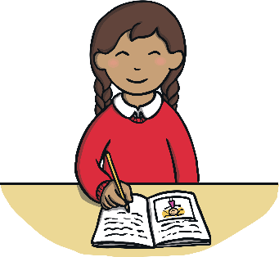
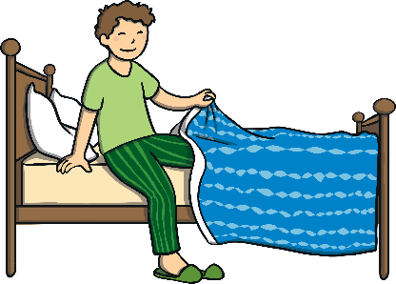
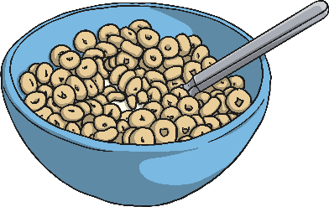

Think about…
What you had for breakfast this morning.
What you will be learning today.
Waking up in your bed this morning.
Think about it!
Do you think all children have had breakfast, will be learning something today or woke up in a bed this morning?

Slide 3
Aim
To begin to understand about world poverty.

Slide 4
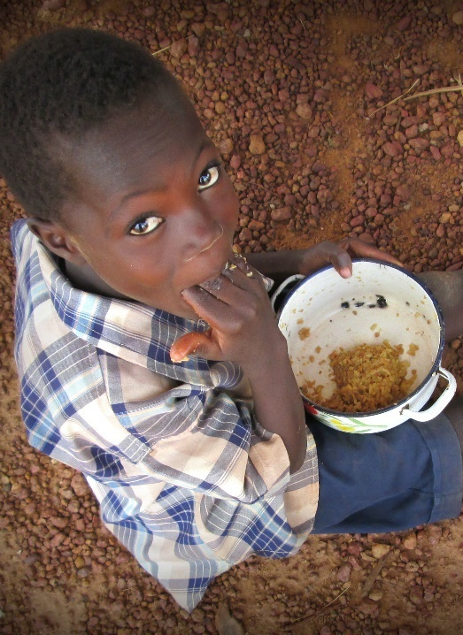
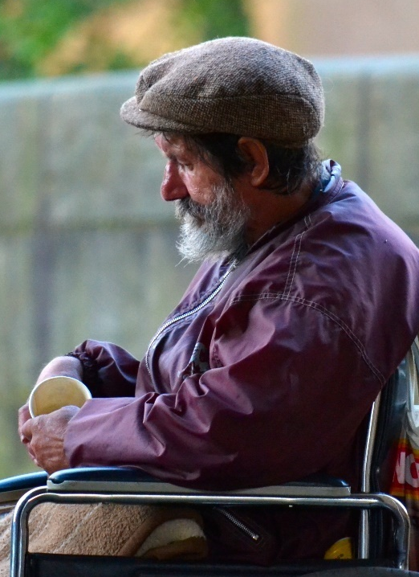

Poverty All around the World
Thousands of people do not have enough healthy food to grow properly.
Thousands of people cannot get medicines or see a doctor when they are ill.
Did you know…?
Over half the number of people living in the world, live in poverty.
Photo courtesy of Adam Jones, FMSC, ptwo and unicefiran (@flickr.com) - granted under creative commons licence – attribution

Slide 5
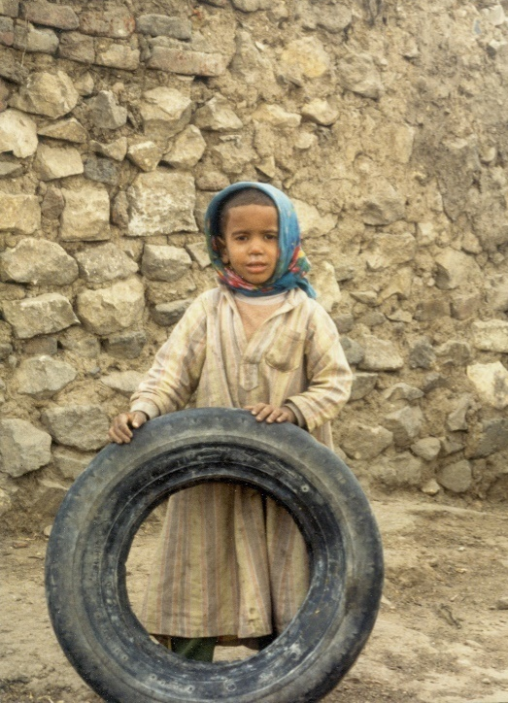
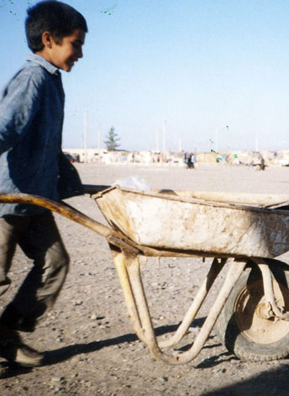
Poverty All around the World
Thousands of people do not live in safe or warm places.
Thousands of children have to work very hard and cannot go to school to learn new things.
Did you know…?
Over half the number of people living in the world, live in poverty.
Photo courtesy of Adam Jones, FMSC, ptwo and unicefiran (@flickr.com) - granted under creative commons licence – attribution

Slide 6
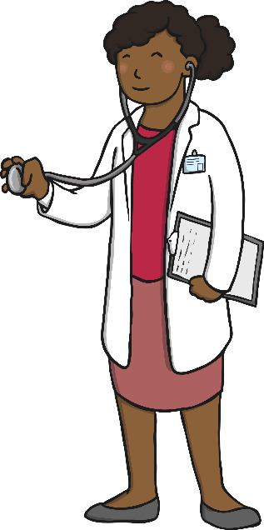

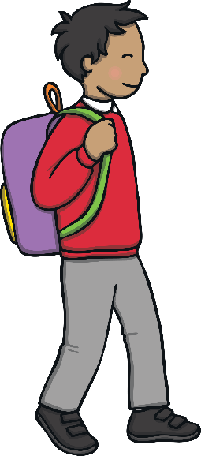
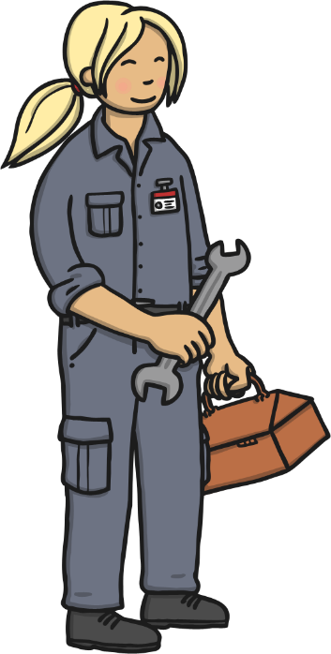
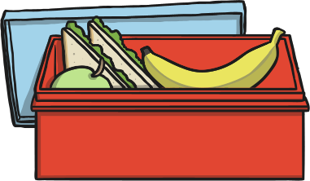
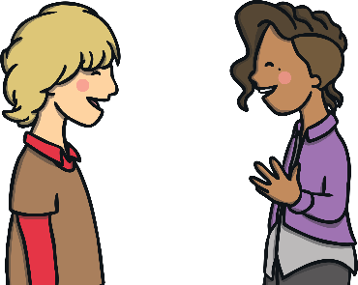
What Poverty Means
Poverty means not having your basic needs met. It means not having:
Good health
Regular, nutritious food
Having a safe place to live
Having an education
Having a job
Discuss it!
Talk to the person next to you and decide which are the top three most important things everyone should have to be able to live well.

Slide 7
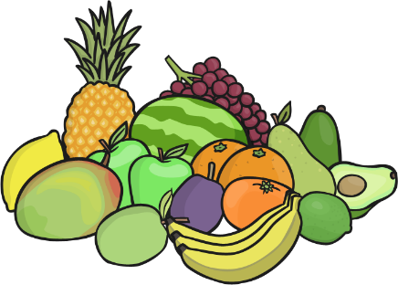
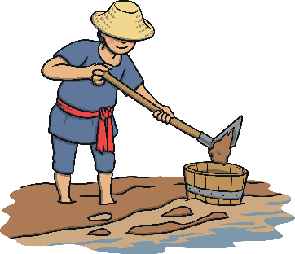

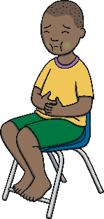
The Poverty Chain
We are lucky in the UK because people are given money, somewhere to live and can be looked after in hospital or see doctors, even if they are not able to work.
In many other countries, this does not happen for people who have no money.
If people do not have healthy food, they cannot grow strong.
If they are not strong, they cannot work.
If they cannot work, they are not able to buy or rent somewhere to live, so they are homeless.
If they are homeless, they are more likely to get ill but cannot afford to get medicines to get well again.

Slide 8



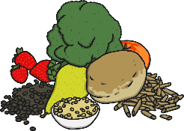
What Can We Do?
Don’t waste these things!
Electricity: Turn off electrical devices and switches when they’re not being used.
Electricity uses fuels which are running out. We should use what we have, carefully.
Clothes: Recycle them at a charity shop or at the supermarket, so they can be used by someone else.
Water: Turn off the taps and shower when you are not using them. We are running out of clean water around the world, so we should save what we have.
Food: Only take or buy what you need. Greed means more food is made which can cause poverty in other countries.

Slide 9
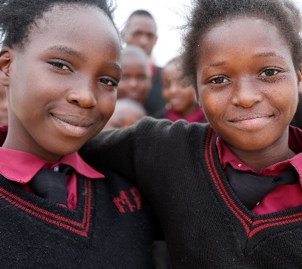
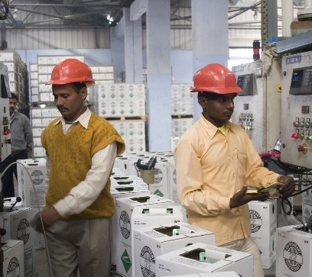
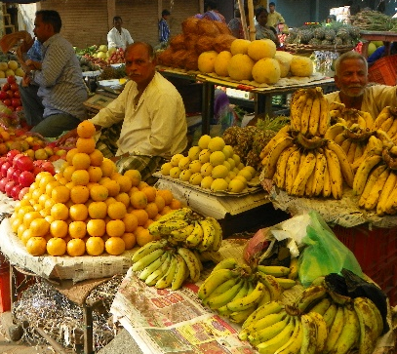
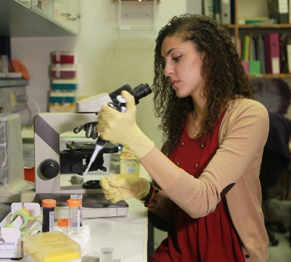
A Better Future
People need to be able to grow their own crops and keep their own animals. They need land and education to help build their own business, get a job and look after themselves. They need to be able to have medical help when they need it, to keep well and look after their families.
Everyone has a right to life.
No one should have to live in poverty.
Photo courtesy of DFID – UK, ILO in Asia and the Pacific, juggadery and Masa Israel Journey (@flickr.com) - granted under creative commons licence – attribution

Slide 10
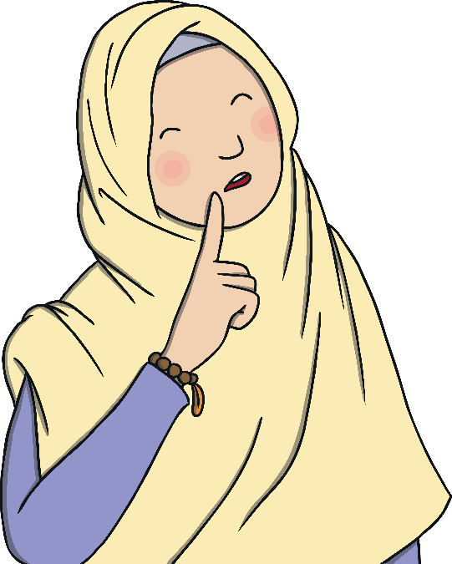
What Will You Change?
Think about what you have learned during this assembly.
What might you do differently now?
What are you grateful for?

